Slide 1
OQS SimLog Aircraft Operations Overview for AMS KA 12/14/2011
Notes:
<Project Name> - Replace with the name of the project
<Initiative Name> - Replace with the name of the Initiative/Program that the Project is a part of. Delete this reference if the Project is stand-alone
<date> - Replace with the date that the Startup Tollgate will occur

Slide 2
OQS SimLog| Project Update
Business Functions
Overview
Maintains records for Flight Simulation Training Devices (FSTD); also referred to as Simulators, SIMS
Simulators are regulated by the FAA. The FAA conducts initial qualification of Simulators and has rules for ongoing qualification and use of the simulators. For example, a check of simulator functionality must be performed within 24 hours of conduction training; any “discrepancies” between simulator functionality and initial qualification standards must be recorded, and any open discrepancies must be reviewed before training can be conducted.
One of the primary functions of OQS SimLog is to record these “discrepancies”
Other functions include: record the daily check (“Preflight”), enter a “time log” of the training that is conducted in the simulators, record if a simulator is “Down” / i.e. unavailable to be used for training
OQS SimLog is also used to manage parts used on the simulators – both the parts that are on the simulators and parts that are in stock and available for use
.
Notes:
Project Summary – Copy and paste the Business Opportunity paragraph from the Startup Tollgate presentation and update as needed.
Project Scope – Copy and Paste the table from the Project Scope slide in the Startup Tollgate presentation and update as needed.
Project Objectives – Copy and Paste the Value Proposition paragraph from the Value and Benefits slide in the Startup Tollgate presentation and update as needed.

Slide 3
OQS SimLog| Project Update
Business Functions
Business Functions
In Scope for Release 1
Manage Discrepancies
Change Device Status
Complete Preflight
Manage Time Log
Manage Parts, Components, and Vendors
Reports: Discrepancy, Preflight, Status, Parts, Components, Vendor, Time Log
Implement functionality for Flight Ops and Inflight Devices
Implement OQS SimLog User Security Profiles for Flight Ops and Inflight
Existing communication with ATOM: Scheduling
Display of Sim status updates on Information Display Monitors
Notes:
Project Summary – Copy and paste the Business Opportunity paragraph from the Startup Tollgate presentation and update as needed.
Project Scope – Copy and Paste the table from the Project Scope slide in the Startup Tollgate presentation and update as needed.
Project Objectives – Copy and Paste the Value Proposition paragraph from the Value and Benefits slide in the Startup Tollgate presentation and update as needed.

Slide 4
OQS SimLog| Business Impact
Business Users / Responsibilities
User Group / Function | Key Responsibilities
Sim Techs | Completing Preflight Changing Device Status Adding discrepancies Entering corrective action for discrepancies Extending discrepancies Adding / Updating / Relocating Parts and Components
Flight Ops Training Managers | Modifying original discrepancy information Adding discrepancies Extending discrepancies
Flight Ops Sim Instructors and Check Pilots | Entering a Time Log for Crew training event in a Simulator Adding discrepancies
Flight Ops Training Scheduler | Updating a saved Time Log Updating schedule for Sim Downtime
FAA Inspectors | Reviewing Open Discrepancies Adding discrepancies
Inflight Users | Completing Preflight for Inflight Devices Changing Device Status for Inflight Devices Adding discrepancies for Inflight Devices Entering corrective action for discrepancies for Inflight Devices Extending discrepancies for Inflight Devices
Administrative Coordinator | Manage Component Repair Manage Vendors
All User Groups | Reviewing Open Discrepancies
FO Training Schedulers (new release) | Add / Update Class Plans Add / Update Class Roster
Notes:
Copy and paste from section 1.0 of the Business Process Change Plan. Describe the business process changes at a high-level. Include process flow diagrams if appropriate.

Slide 5
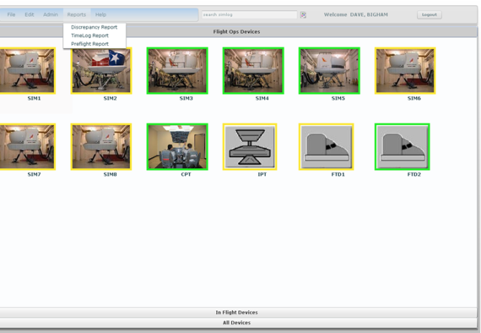
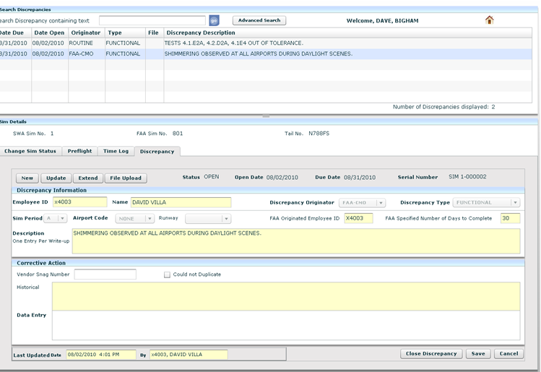
OQS SimLog | Business Requirements
User Interfaces
Notes:
Copy and paste this information from Section 6 of the Business Requirements document.
Identify user interfaces by Role and Activity, indicating which Business Process Flows are involved.
Avoid making assumptions about how these will be implemented.
User interfaces facilitate interactions like data entry, information display, or printout.

Slide 6
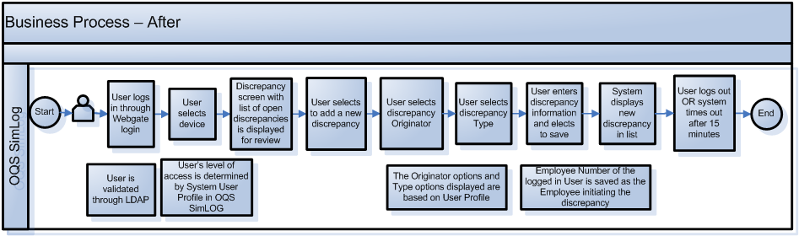
OQS SimLog | Business Requirements
Business Process Flows
Notes:
Copy and paste the information from Section 5 of the Business Requirements document.
Definition: A process flow chart is a diagram that uses graphic symbols to describe the flow of the steps in a process. If the process already exists but is undergoing changes, it may be helpful to first create a current state diagram to depict how a process currently works and then create a future state diagram to show how the process will ultimately be performed.
Process flows are useful for:
Documenting process and showing interrelationships of process steps.
Identifying actual and ideal paths for process flows
Early identification of problems and improvements
Training end users or new employees
Symbols used in Business Process Flow diagrams are:
Note: If using Visio, all symbols are found in Basic Flowchart Shapes.
Flowchart Diagram Guidelines:
Describe the process you are documenting in a short statement (i.e. Performing a Refund)
Identify initial inputs to the process followed by the successive steps (operations) of the process
Identify decision points where the processes branches into alternative flows
End with the culminating final step

Slide 7
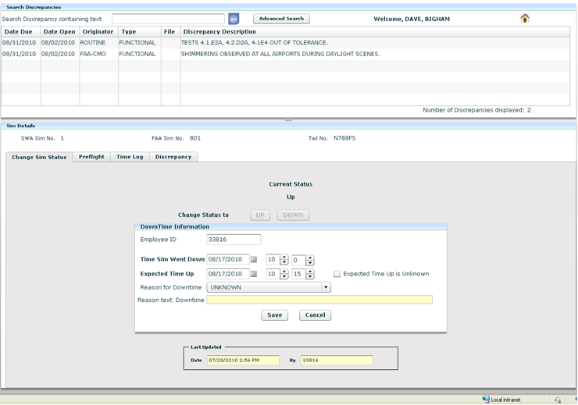
OQS SimLog | Business Requirements
User Interfaces
Notes:
Copy and paste this information from Section 6 of the Business Requirements document.
Identify user interfaces by Role and Activity, indicating which Business Process Flows are involved.
Avoid making assumptions about how these will be implemented.
User interfaces facilitate interactions like data entry, information display, or printout.

Slide 8
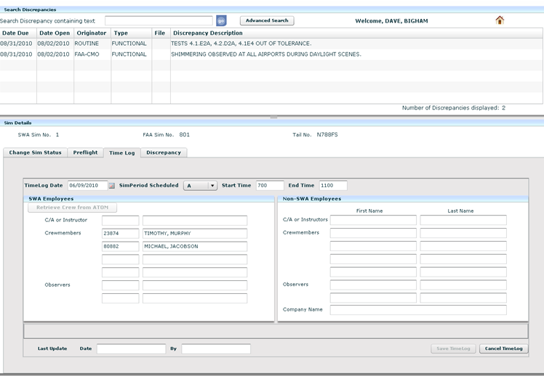
OQS SimLog | Business Requirements
User Interfaces
Notes:
Copy and paste this information from Section 6 of the Business Requirements document.
Identify user interfaces by Role and Activity, indicating which Business Process Flows are involved.
Avoid making assumptions about how these will be implemented.
User interfaces facilitate interactions like data entry, information display, or printout.

Slide 9
OQS SimLog| Project Update
SimLog / Recordkeeping Differences and Similarities
Differences between SimLog (SL) and Recordkeeping (RK)
SL: FLEX / Blaze DS RK: JavaScript, YUI
SL: LDAP /Webgate login RK: SWA Life
SL: Flight Ops and Inflight RK: Flight Ops and Dispatch
SL: Read Only Version of Application; deployed to the auto-login PCs outside the Simulators; auto-login with generic ID
SL: Sim Status URL displayed on the Video Display Terminals at Flight Ops Training Center (including in FO Training Scheduler area
Similarities between SimLog (SL) and Recordkeeping (RK)
Database
Frameworks / Mule Servers
Component
Batch Servers
.
Notes:
Project Summary – Copy and paste the Business Opportunity paragraph from the Startup Tollgate presentation and update as needed.
Project Scope – Copy and Paste the table from the Project Scope slide in the Startup Tollgate presentation and update as needed.
Project Objectives – Copy and Paste the Value Proposition paragraph from the Value and Benefits slide in the Startup Tollgate presentation and update as needed.

Slide 10
OQS SimLog| Project Update
IM Remedy Tickets
User can’t access SimLog
Must be in LDAP with a profile that can access SimLog
If member of the dynamic groups, added automatically; if not, need to be added to static group
Dynamic groups: Sim Tech, Sim Instructors, Check Pilots, Training Schedulers, Inflight Training Supervisor
Static Group: Managers, Technology support, Maintenance Technicians
Owner for Static Group: Technology – Chris Martin; Admin: Rosa Rinaldi
Owner for Static Group: Business – Steve Smith; Admin: Debbie Jimison, Mike Washam, Dave Bigham, Janelle Hawley (Inflight)
Must be in OQS Database: System User Table, System User Role Access table
If in LDAP but not in OQS, generates a low error
Notes:
Project Summary – Copy and paste the Business Opportunity paragraph from the Startup Tollgate presentation and update as needed.
Project Scope – Copy and Paste the table from the Project Scope slide in the Startup Tollgate presentation and update as needed.
Project Objectives – Copy and Paste the Value Proposition paragraph from the Value and Benefits slide in the Startup Tollgate presentation and update as needed.

Slide 11
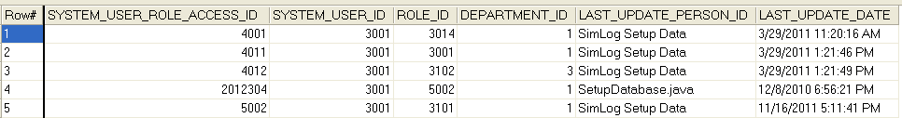
OQS SimLog| Project Update
IM Remedy Tickets
User can’t access SimLog (continue)
Procedure to get access:
Customer approval for Flight Ops: Steve Smith, Manager Sim Techs
Customer approval for Inflight: Janelle Hawley (Inflight Training Supervisor) or Larry Parrigin (Manager)
If not in dynamic group, add to static group: Steve Smith for FO; Janelle Hawley for IF; Rosa Rinaldi: Technology
SR to add to OQS Database; OQS team adds to Database
SYSTEM_USER table
SYSTEM_USER_ROLE_ACCESS table
Notes:
Project Summary – Copy and paste the Business Opportunity paragraph from the Startup Tollgate presentation and update as needed.
Project Scope – Copy and Paste the table from the Project Scope slide in the Startup Tollgate presentation and update as needed.
Project Objectives – Copy and Paste the Value Proposition paragraph from the Value and Benefits slide in the Startup Tollgate presentation and update as needed.

Slide 12
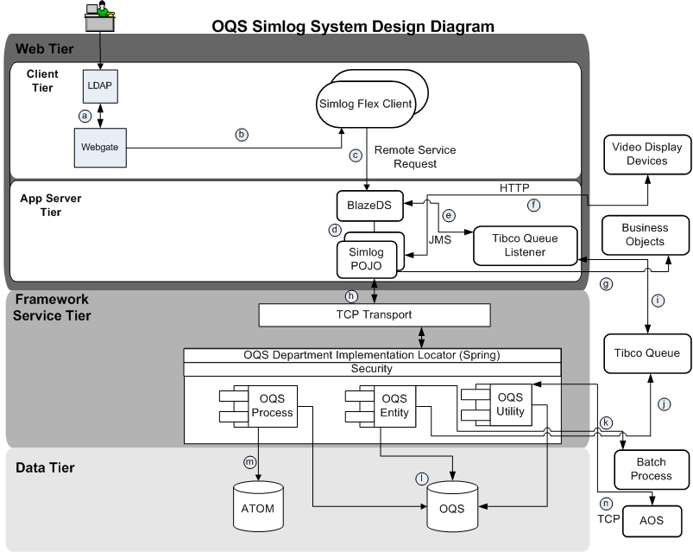
OQS SimLog| Design
System Design Diagram
Notes:
Copy and paste section 2.0 from the System Design document. Insert reference diagram that breaks the system down into major components. Use the SWA Way Visio Stencils to create these diagrams.
Document any system design features that were not included in the System Concept; stay at a high level so that the intent of the system is not obscured by too much detail.
Label each interface for reference in the Interfaces section.

Slide 13
OQS SimLog| Design - Design Overview
Component Overviews
Resource Component
Resource component is an entity level component that handles core business services functionality for managing SimLog training devices.
Some of the key functionalities include:
Managing discrepancies such as adding /updating discrepancies against training devices and searching for existing discrepancies.
Changing device status from Up to Down and vice versa either manually or through automation. For example: if there is a discrepancy that is past due, then the system automatically updates the device status to down.
Handling Preflight for training devices. This mainly has to do with correctly updating preflight indicator based on the preflight frequency for each device that needs preflight.
Managing TimeLog entries (i.e. creating new entries or retrieving existing entries from ATOM) for Crewmembers and/or Contractors who are scheduled to use the simulator for a given shift period.
SimLogParts Component
SimLogParts component is an entity level component that mainly deals with inventory management by managing simulator parts (i.e. Consumables, Repairables and Aircraft Rotables) used inside training devices.
Some of the key functionalities include:
Adding new parts (i.e. Consumables, Repairables and Rotables) into inventory database. Also, updating and searching for existing parts that already exist in the inventory.
Notes:
Copy and paste section 3.0 from the System Design document.

Slide 14
OQS SimLog| Design - Design Overview
Component Overviews
Sending SimLog Repairable parts to vendor for repair.
Receiving SimLog Repairable parts from vendor after repair.
Sending Aircraft Rotable parts to maintenance for repair.
Receiving Aircraft Rotable parts from maintenance after repair.
Adding and updating vendor list that will be used for sending and receiving repairable parts to/from repair.
SimLogManager Component
SimLogManager component is a process level component that works as a manager by interacting with lower level entity and utility components.
SimLogManager plays key roles in flows such as saving TimeLog entries, retrieving TimeLog entries from ATOM etc. that involves interaction with more than 1 entity/utility component (i.e. Resource and Person components).
Notes:
Copy and paste section 3.0 from the System Design document.

Slide 15
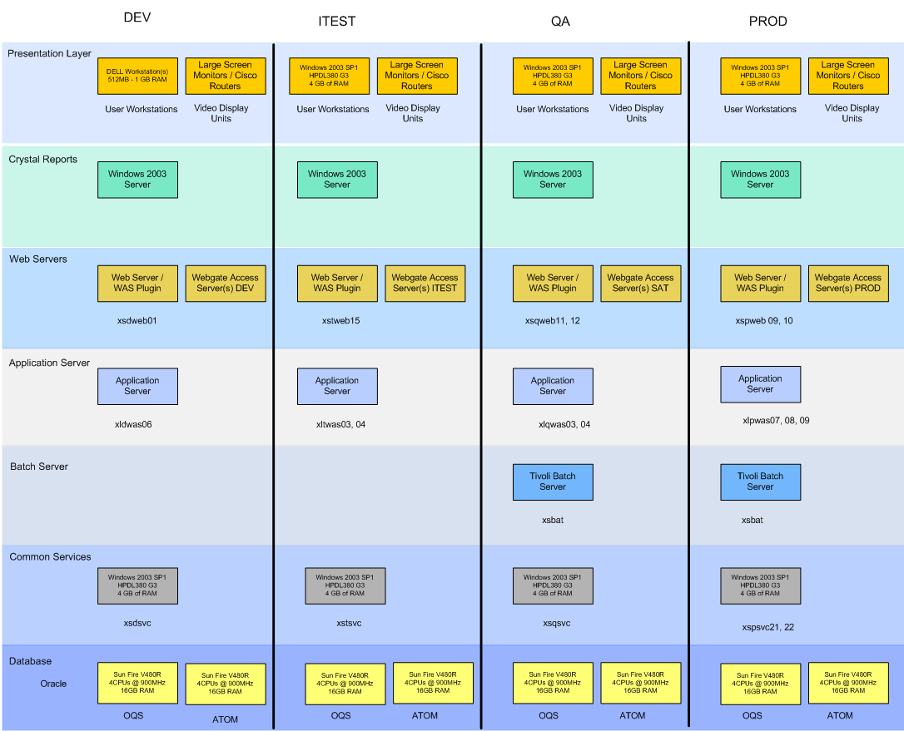
OQS SimLog| Design - Infrastructure Overview
System Deployment
Diagrams
Notes:
Copy and paste section 1.0 from the Component Design document. Give a picture of how the processes reside in production.

Slide 16
OQS SimLog| Design - Infrastructure Overview
Servers
Red font represents differences from OQS Recordkeeping
SIMLOG (SL) legend: red text indicates SimLog differences from RK
 | Environment / Servers
 | PROD | SDC | SAT | ITEST | DEV | ETL
Websphere / i.e. Application Servers | xlpwas07/08/09 | xlswas01 | xlqwas03/04 | xltwas03/04 | xldwas06
Frameworks/Mule same as RK | xspsvc21 xspsvc22 | xspsvc15 xspsvc16 | xsqsvc07 xsqsvc08 | xstsvc01 xstsvc02 | xsdsvc05 xsdsvc06
AOS - Our service is called 'Enterprise Facility Service' version 1.6.0. |  |  | xlqsvc03/04 |  | xldsvc03/04/05/06/07
Batch | xspbat01 |  | xsqsvc01 xsqsvc02
Web Servers | xspweb09/10 | xspweb08 | xsqweb11/12 | xstweb15 | xsdweb01
OQS database | SHRTFRP xlprac11 xlprac12 | SHRTFRP xlsrac09 xlsrac10 | SHRTFRQ xlqodb05 xlqodb06 | SHRTFRD OQS_ADMIN xldodb01 xldodb02 xldodb03 xldodb04 | SHRTFRD OQS_DEV_ADMIN xldodb01 xldodb02 xldodb03 xldodb04
BO Servers | swara.swacorp.com ms2boe11 – 18, msboe19 – 20 |  | swaraqa.swacorp.com msqaboe11 – 15 | swaradevt.swacorp.com Alpha: swaradeva.swacorp.com | swaradev.swacorp.com msdevboe01 – 04
Notes:
Copy and paste section 7.0 from the Infrastructure Plan document.
Identify Environment
[Anticipated production environment needs. Servers, storage, networking, etc. Add environments for your services as appropriate.]
Date Needed
[Indicate date(s) that any new hardware/software will be needed in production.]
Software
[List software that will need to be added to the production environment. Please identify any specific versions needed. Refer to section 4.3 if convenient]
Sizing Information
[Please provide estimates for the following items. If not used, just leave blank. If used but there is no way to estimate size now then insert a question mark. Please try to give some estimates even if they have to be wild guesses that you refine later.]

